Slide 1


Test Automation Framework

Slide 2
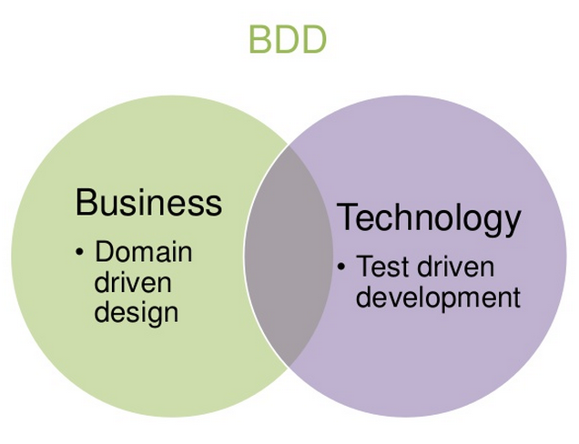
BDD approach

Slide 3
Why BDD?
All the stakeholders can able to understand the ‘what’ is being tested
Can use human readable languages to create test scripts
Ease of fabrication and maintenance

Slide 4


Ruby - Cucumber
Ruby – a dynamic, reflective, object-oriented, general-purpose programming language, designed and developed in the mid-1990s by Yukihiro "Matz" Matsumoto in Japan
Cucumber - an Open source BDD tool
Gherkin – parse human readable languages for writing test scripts

Slide 5
eHR Framework stack
Since Cucumber is used, the eHR TAF has the basic skeleton of cucumber with added utils and other components for automation
RubyMine is used for creation and maintenance of the framework components
SVN is used for source code version control and Jenkins for continuous integration
The TAF includes both desktop and mobile web app automation scripts

Slide 6
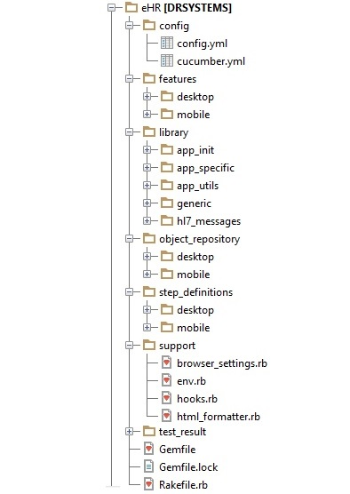

Slide 7
TAF Components
config
  config.yml - holds the various users profiles and global environment values used in run
  cucumber.yml - holds the cucumber run profiles with custom settings
features
  desktop - holds desktop web feature files
  mobile - holds mobile web feature files

Slide 8
TAF Components (cont.)
library
  app_init - driver module for executing cucumber tests
  app_specific - holds library modules related to application under test
  app_utils - holds the external dependent files
  generic - holds the library modules that can be used in and out of TAF
  hl7_messsages - holds the HL7 message template files

Slide 9
TAF Components (cont.)
object_repository
  desktop - holds the desktop web page-object classes
  mobile - holds the mobile web page-object classes
step_definitions
  desktop - holds the desktop web step definition files
  mobile - holds the mobile web step definition files

Slide 10
TAF Components (cont.)
support
  browser_settings.rb - holds the browser related profile settings
  env.rb - includes the ruby-cucumber library files required
  hooks.rb - holds the cucumber hooks where test case pre and post conditions are set
  html_formatter.rb - holds the custom html report class

Slide 11
TAF Components (cont.)
test_result
  Holds the execution result logs that includes module logs and execution summary as custom html report file
Gemfile – holds the gems required in TAF libraries
Rakefile.rb – holds the rake tasks

Slide 12
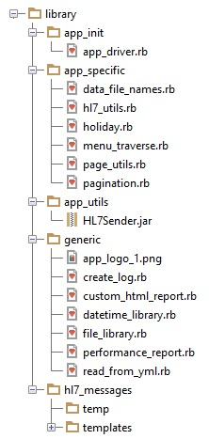
TAF Library

Slide 13
TAF Library
app_init
  app_driver.rb - a driver class file that drives cucumber execution
app_specific
  data_file_names.rb - holds the test data file (yml) names as constant
  hl7_utils.rb - holds the HL7 messaging utility class methods
  holiday.rb - holds US federal holiday utility class methods
  menu_traverse.rb - holds the menu and sub menu names as constant
  page_utils.rb - holds the generic ruby and page-object methods
  pagination.rb - holds the pagination utility methods

Slide 14
TAF Library (cont.)
app_utils
  HL7Sender.jar - a java library file for HL7 messaging
generic
  app_logo_1.png - application logo
  create_log.rb - creates custom run log files
  custom_html_report.rb - creates custom html report files
  datetime_library.rb - holds the datetime manipulation methods
  file_library.rb - holds the file manipulation methods
  performance_report.rb – creates performance report
  read_from_yml.rb - holds yml file manipulation methods

Slide 15
TAF Library (cont.)
hl7_messsages
  temp - holds the HL7 message file created during run
  templates - holds the HL7 message templates

